Slide 1

Computer Networks
COMPUTER NETWORKS
Piyush Narula (2022354) Aditya Aggrawal (2022028)

Slide 2

TCP WEB SERVER
The first line is provided in the skeleton code. It creates a new socket object for the server, which will be used to establish a connection to the client. AF_NET specifies that the socket will be using IPv4 addresses. SOCK_STREAM ensures that a TCP connection is established.
The second line binds the socket to port number 6789. This is an unreserved port that can be used for our connection. The empty string in the bind function tells the server to accept connections on any network interface of the machine.
The third line tells the server socket to start listening for incoming connections. The parameter ‘1’ passed inside the function indicates the backlog, which is the number of pending connections the system will allow to queue up before it starts blocking them.

Slide 3
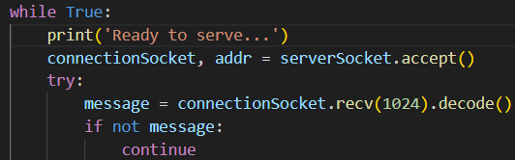
TCP WEB SERVER
Start an infinite loop to continuously serve client requests.
The first line accepts an incoming TCP connection from a client. It waits (blocks) until a client initiates a connection. When a client tries to connect, the method returns a new socket object (connectionSocket) and the address of the client (addr).
The next segment tries to read up to 1024 bytes of data from the client, i.e., an HTTP request). We maintain a buffer size of 1024 bytes.
The next line is error handling. If the message is not found, continue to serve.

Slide 4

TCP WEB SERVER
We expect a request from the client as “GET /index.html HTTP/1.1”. By splitting the message and choosing the first index, we set the filename as “/index.html HTTP/1.1". Then, open the file with the filename starting from the first index to eliminate the ‘/’ character. Store the file contents in the variable outputdata. Close the file reader.

Slide 5
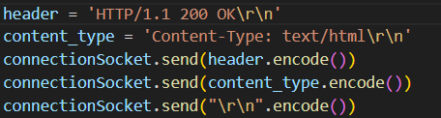
TCP WEB SERVER
Construct the HTTP header consisting of the version of the HTTP protocol, status code, and the message to indicate a successful connection and a return and newline character sequence.
content-type is an HTTP header that tells the client what type of data is sent to the response body. In this case, the content content being sent is HTML.
These headers are then encoded and sent to the client web page so that it can load the HTML page on the browser.

Slide 6

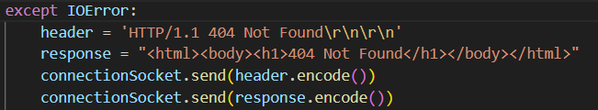
TCP WEB SERVER
The first segment iterates over the contents of the HTML file and encodes and sends the contents to the client character by character. At the end, it sends the return and newline characters to indicate that the entire data required to load the HTML page has been sent.
The second segment shows the error handling counterpart of the earlier shown try segment. In case the server fails to establish a connection, construct an HTTP response header indicating that the requested resource could not be found. Also, prepare an HTML page to indicate to the user that the page cannot be found. Encode and send this message to the client

Slide 7
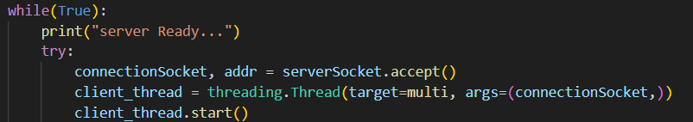
MULTI-THREADED TCP SERVER
The infinite while loop ensures that the server continuously accepts new client connections on a thread until the thread encounters an error.
The first line inside the try block accepts an incoming TCP connection from a client. It stores the client socket object and the client address.
The next line is crucial for this part. It creates a new thread of execution. This allows the server to handle multiple clients concurrently without waiting for one client to finish before serving another. The target parameter specifies the function (multi) that will be executed on the new thread. The argument passed to the target function is the connection socket object to the specific client.
The last line starts the execution of the new thread.

Slide 8

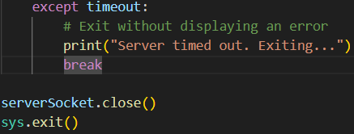
MULTI-THREADED TCP SERVER
The listen() function specifies that 3 incoming connections can wait in the queue if the server is busy handling other connections. In contrast to the previous part, the server listens for more than one connection this time due to being multi-threaded.
The settimeout() function specifies a timeout of 10 seconds. This means that the socket call will wait for a maximum of 10 seconds for a client connection. If no client connects within 10 seconds, the accept() method will raise a timeout exception.
If a timeout occurs, the thread will enter the except block, where the while loop will break, the specific socket will be closed, and the thread will exit.

Slide 9
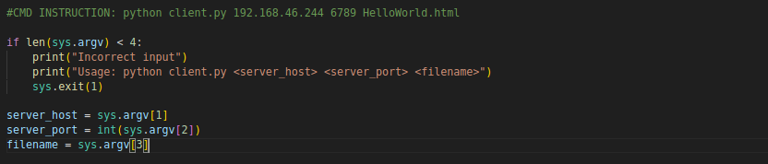
HTTP CLIENT TO TEST YOUR SERVER.
this is used to check whether the input command sent is correct or not.
this must follow this format for input i.e client.py server_host server_port filename
if it does not follow this format then it will return the incorrect input
Later those values are being extracted from input for further use.

Slide 10
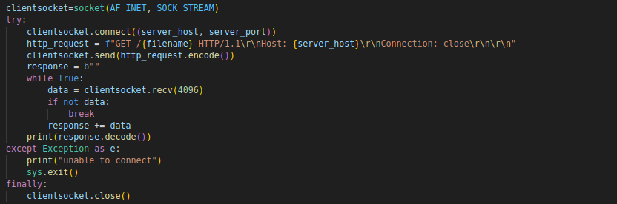

HTTP CLIENT TO TEST YOUR SERVER.
A TCP socket is created using the IPv4 address.
The socket connects to the specified server using its hostname and port number.
An HTTP GET request is formatted to request a specific file from the server.
The client continuously receives data from the server until there is no more data available.
The received byte response is decoded and printed as a string.
If any error occurs during the connection, an error message is displayed and the program exits.
The socket is closed to free up resources, ensuring proper cleanup after operations.

Slide 11
HTTP CLIENT TO TEST YOUR SERVER.
1..5: Generates a sequence of numbers from 1 to 5 for iterations.
| ForEach-Object { ... }: Processes each number in the sequence.
Start-Process: Starts a new process (a new PowerShell window).
Powershell: Specifies that a new PowerShell instance should be launched.
ArgumentList: Specifies the arguments to be passed to the new PowerShell process:
"-NoExit": Keeps the window open after execution.
"-Command": Indicates that the next string is a command to run.
"python clientQuestion3.py <IPv4> 6789 HelloWorld.html": Runs the Python script with the specified IP address, port, and filename.

